Slide 1
Endpoint Protection Using Zero Trust Principles
<speaker>
<title>

Slide 2
Module overview
Endpoint Security Overview
Intune Endpoint Security
Microsoft Defender Components
Compliance Policies
Understanding Compliance
Compliance Policies & Settings
Assign & Monitor Compliance Policies
Conditional Access
Conditional Access Overview
Device-based Conditional Access Policies
App-based Conditional Access Policies

Slide 3
Module overview
Microsoft Defender for Endpoint Integration
Enable integration with Intune
Security tasks
Audit reporting
Connecting to Microsoft Sentinel
Intune
Defender for Endpoint

Slide 4
Endpoint security overview
Intune endpoint security
Microsoft Defender Components

Slide 5
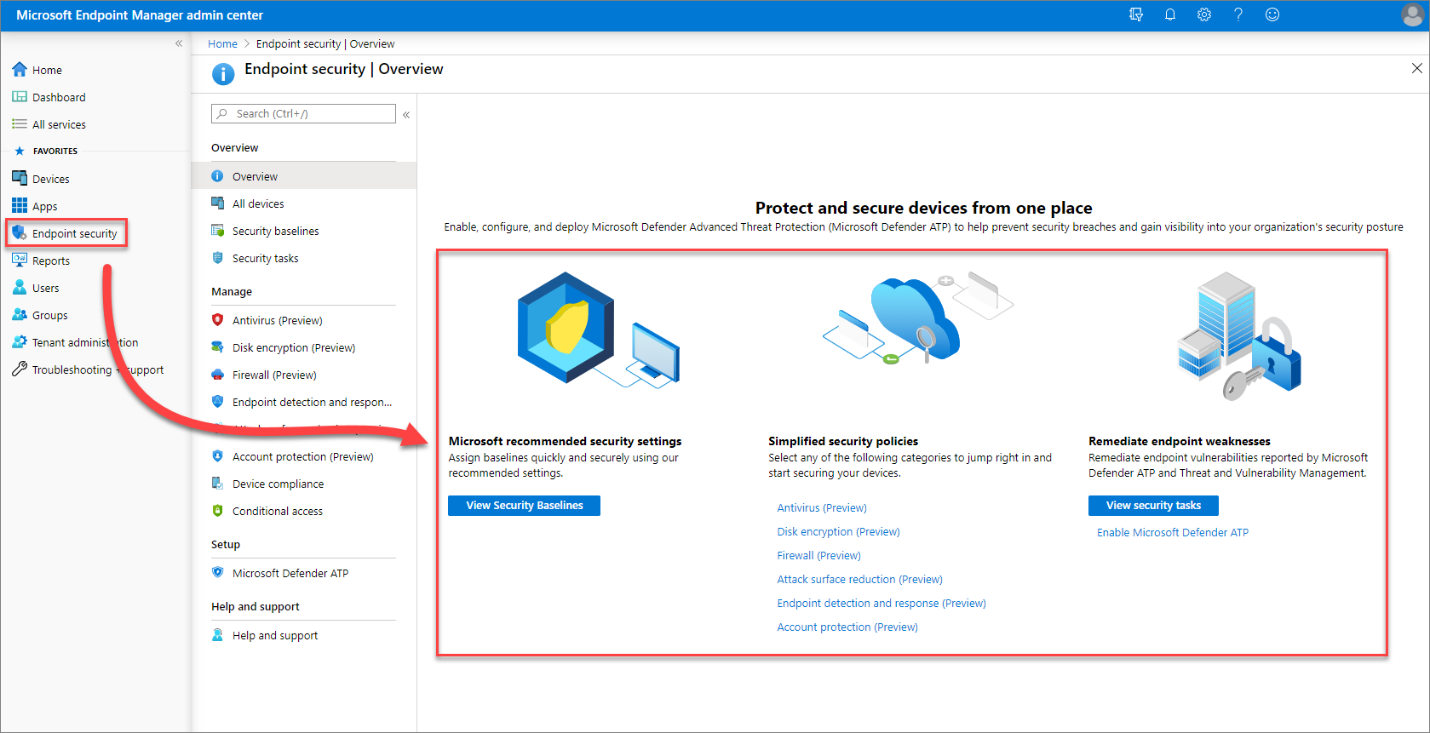
Protect and secure devices

Slide 6
Endpoint Security
Endpoint detection and response
Used to manage Endpoint Detection and Response (EDR) settings for devices onboarded to Microsoft Defender for Endpoint (MDE)
Antivirus
Contains settings to manage Microsoft Defender for Endpoint Antimalware solution
Disk Encryption
Used to manage a device’s built-in encryption method, i.e. macOS FileVault or Windows 10/11 BitLocker
Defender Firewall
Configure a device’s built-in firewall in macOS and Windows 10/11. Windows 10/11 profiles contain advanced security settings and granular firewall rules
Attack Surface Reduction
Contains settings to configure Application Guard, Web Protection, Application Control, ASR Rules, Exploit Protection and Device Control
Account Protection
Used to manage settings for Windows Hello for Business and Credential Guard
Microsoft Security Baselines
Microsoft recommended configuration settings based on feedback from Microsoft security engineering teams, product groups, partners and customers

Slide 7

Security by default
Cloud
Cloud Services
Defender, OneDrive & OneDrive Vault, AAD. MSA, Attestation, Modern Device Management (MDM)
Identity and Privacy
Secured Identity
Privacy Controls
Windows Hello
Biometrics
Fast Identity Online (FIDO)
Authenticator App
Smart Cards
Access Control
Credential Protection
Transparency and Audit Trail
Location, Camera, and Microphone
Application Security
Application
Application Control
User Account Control (UAC)
App Isolation (incl. Office + Edge)
Secure Apps
Advance the journey across the Zero Trust security model
Encryption and Data Protection
Network Security
Virus and Threat Protection
BitLocker
Encrypted Hard Drive
Email Encryption
Transport Layer Security (TLS)
DNS Security
Bluetooth Protection
Wi-fi Security
VPN
Windows Defender Firewall
SMB File Services
Microsoft Defender Antivirus
Microsoft Defender SmartScreen
Microsoft Defender for Endpoint
Operating System
System Security
Trusted Boot
Cryptography
Certificates
Code Signing and Integrity
Device Health Attestation Security (setting) App
Hardware (Chip)
Hardware Root-of-Trust
Silicon Assisted Security
TPM 2.0
Microsoft Pluton Security Processor
Secured Kernel
Identity Protection
Firmware Protection
DMA and Memory Protection
Security Foundation
Security Assurance
Certification
Secure Supply Chain
SDL Bug Bounty
CC, FIPS
Software Bill of Materials (SBOM), Code Signing

Slide 8
Endpoint security configuration recommendations
Work with your security team to identify organizational endpoint security requirements.
Review the most-secure recommendations provided in security baselines.
Create and deploy simplified security policies that meet your endpoint security needs.
Use device configuration profiles for any gaps.

Slide 9
Compliance Policies
Understanding compliance
Compliance policies & settings
Assign & monitor compliance policies

Slide 10
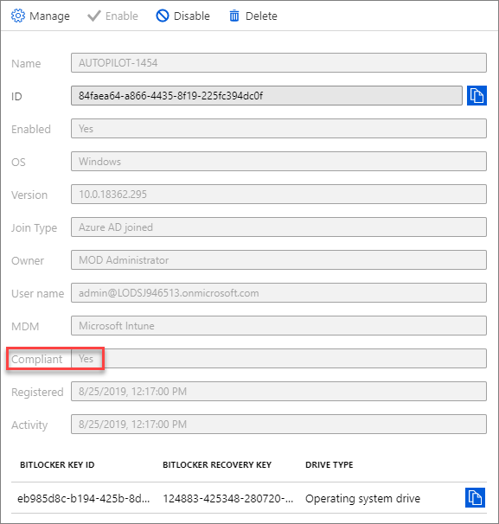
Understanding compliance
When a device enrolls in Intune it registers with Azure AD. A key piece of information stored in Azure AD for each device is its compliance status.
Intune sets the device compliance status by checking whether devices meet some requirements.
The Intune feature used to set those requirements is called compliance policies.
Notes:
Ref: https://docs.microsoft.com/en-us/intune/device-compliance-get-started
For example, an Intune administrator can require:
Passwords to access organizational data on mobile devices
Devices aren’t jail-broken or rooted
A minimum or maximum device operating system version
The device to be at, or under, a threat level

Slide 11
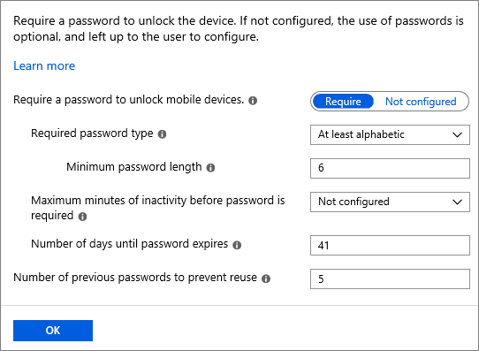
Compliance policies
Compliance policies define the rules and settings that users and devices must meet to be marked compliant in Azure AD.
When combined with Conditional Access, administrators can block users and devices that don't meet the compliance policy requirements.
Device compliance policies can be used for reporting regardless of whether you are using Conditional Access or not.
Notes:
https://docs.microsoft.com/en-us/intune/device-compliance-get-started
Require a PIN, Encryption, Jailbreak detection, Minimum/maximum OS version, etc.
You can use compliance policies to report compliance without blocking access.

Slide 12
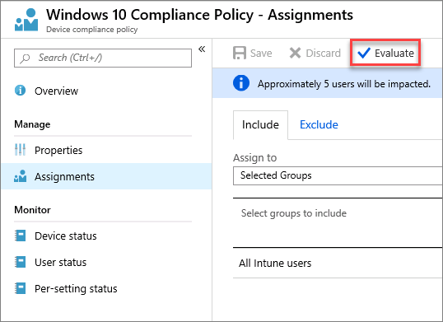
Assign compliance policies
Compliance policies can be assigned to users or devices.
When a compliance policy is assigned to a user, all the user's devices are checked for compliance.
It is not recommended to mix and match user groups and device groups when excluding assignments.
Intune doesn't consider user-to-device association when it excludes groups
Notes:
Intune provides pre-created All Users and All Devices groups in the console. The groups have built-in optimizations for your convenience. It's highly recommended that you use these groups to target all users and all devices instead of any "all users" or "all devices" groups that you might create yourself.
https://docs.microsoft.com/en-us/azure/active-directory/users-groups-roles/licensing-groups-assign
Intune doesn't consider user-to-device association when it excludes groups. Including user groups while excluding device groups is unlikely to produce the results you need. Inclusion takes precedence over exclusion. For example, if you target an iOS app to All Users and exclude All iPads, the net result is that any user who is using an iPad still gets the app. However, if you target the iOS app to All Devices and exclude All iPads, the deployment will be successful.
https://docs.microsoft.com/en-us/intune/apps-inc-exl-assignments

Slide 13
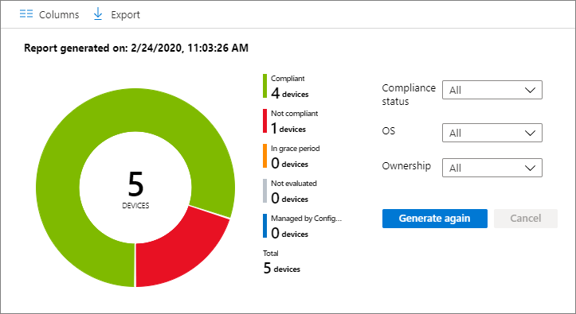
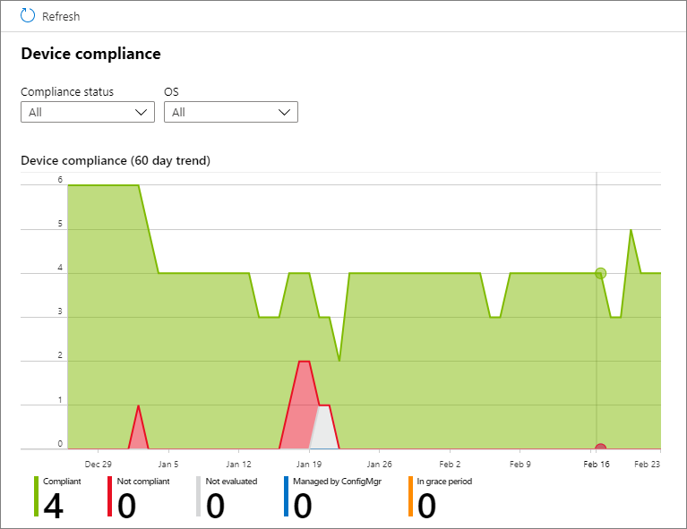
Device compliance reports
Device compliance reports are meant to be broad in nature and provide a more traditional reporting view of data to identify aggregated metrics.
These reports are designed to work with large datasets to get a full device compliance picture.
Sign into the Microsoft Endpoint Manager Admin Center → select Reports to view the reports summary → select Device compliance or Trends.

Slide 14
Conditional Access
Conditional Access Overview
Device-based conditional access
App-based conditional access
Notes:
Intune uses Azure Active Directory (AD) Conditional Access to help enforce compliance. When a device enrolls in Intune, the Azure AD registration process starts, and device information is updated in Azure AD. One key piece of information is the device compliance status. This compliance status is used by Conditional Access policies to block or allow access to e-mail and other organization resources.
Conditional Access interactive guide: Configure Conditional Access in Azure AD (cloudguides.com)

Slide 15

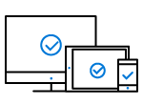


What is conditional access?
Conditional access enables an organization to enforce controls to applications and devices based on specific conditions from a central location.
User- and location-based conditional access
Device-based conditional access
Application-based conditional access
Risk-based conditional access
Keep sensitive data protected by limiting user access based on geo-location or IP address with location-based conditional access policies.
Ensure only enrolled and approved devices can access corporate data with device-based conditional access.
Secure access to corporate cloud and on‑premises apps and maintain control with conditional access.
Protect your data from malicious hackers with a conditional access policy to identify risky sign-in behavior.

Slide 16
Examples for conditional access
User- and location-based conditional access
Device-based conditional access
Application-based conditional access
Risk-based conditional access
Control access to cloud apps based on the network location of a user.
Allows the creation of trusted IP address ranges
Traffic from entire countries IP ranges can be blocked or allowed.
The location condition is commonly used to block access from countries where traffic should not come from.
Allows or blocks access for users with devices
of specific platforms (like “block Android” or “allow iOS”) or
marked with a specific state (like “allow only Intune enrolled”)
Identify devices that meet compliance requirements such as:
Requiring a PIN to unlock
Requiring device encryption
Requiring a minimum operating system version
Requiring a device is not jailbroken or rooted
Access to corporate cloud and on‑premises apps
requires modern authentication and blocks legacy authentication protocols
requires multi-factor authentication (MFA) on administrative accounts (like Global administrator or Exchange Admins)
Allows to identify risky sign-in behavior and to enforce policies for users to perform
password changes or
multi-factor authentication
to reduce the risk level.
Users can also be blocked from access until an administrator takes manual action.
Azure AD Premium P2 licenses required

Slide 17








How does conditional access work?
Assignments
Conditions
Controls
Policy Application
Assign policies to users, applications and devices
Policy Evaluation
Conditions determine when restrictions apply
Apply Restrictions
Controls determine when access will be granted

Slide 18
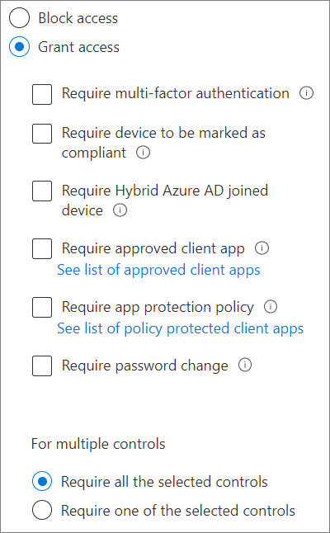
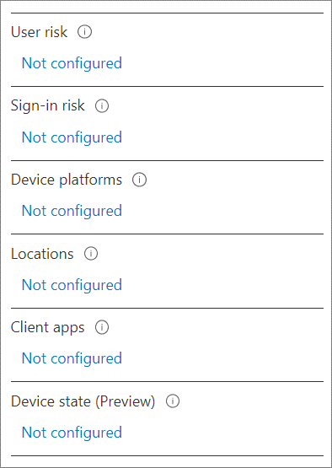
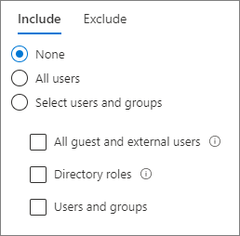
Conditional access policies
Define Who (users), What (apps), How (conditions)
Conditions – “When this happens”
Controls – “Then do this”
Notes:
Conditional Access is not intended as a first line defense for scenarios like denial-of-service (DoS) attacks, but can utilize signals from these events to determine access. Conditional Access policies are used to control how users access apps.
Enforced after the first-factor authentication has been completed.
Can be device-based (company-owned devices) or app-based (company-owned or BYOD devices using app protection policies).
In a Conditional Access policy, you define the response (control) to the reason triggering your policy (condition).

Slide 19
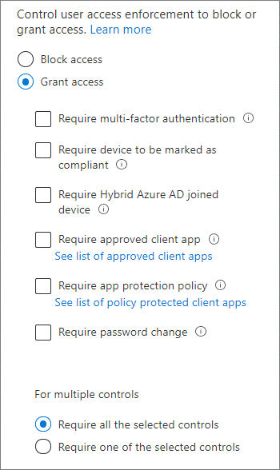
Conditional access policy controls
Block access
Grant access based on one or more controls (actions)
Terms of Use
Ensures users see relevant disclaimers for legal or compliance requirements
Multiple control selection
When multiple controls are selected, you can require all controls or just require one to satisfy the access control conditions.
Notes:
Approved client apps: https://docs.microsoft.com/en-us/azure/active-directory/conditional-access/technical-reference#approved-client-app-requirement
https://docs.microsoft.com/en-us/azure/active-directory/conditional-access/technical-reference#app-protection-policy-requirement
Microsoft Cortana
Microsoft Edge
Microsoft OneDrive
Microsoft Outlook
Microsoft Planner

Slide 20
How Conditional Access polices are applied
Conditional Access policies are additive
More than one Conditional Access policy may apply when you access a cloud app. If this happens, all policies that apply must be satisfied.
Block access trumps all other configuration settings.
For example, if you need to configure a location condition that applies to all connections made from outside your organization's network:
Include All locations
Exclude All trusted IPs
As a best practice, create a user account that is:
Dedicated to policy administration
Excluded from all your policies
Notes:
https://docs.microsoft.com/en-us/azure/active-directory/conditional-access/best-practices
We recommend two break-glass accounts per tenant at least. These accounts should be cloud-only accounts that use the *.onmicrosoft.com domain and that are not federated or synchronized from an on-premises environment.

Slide 21
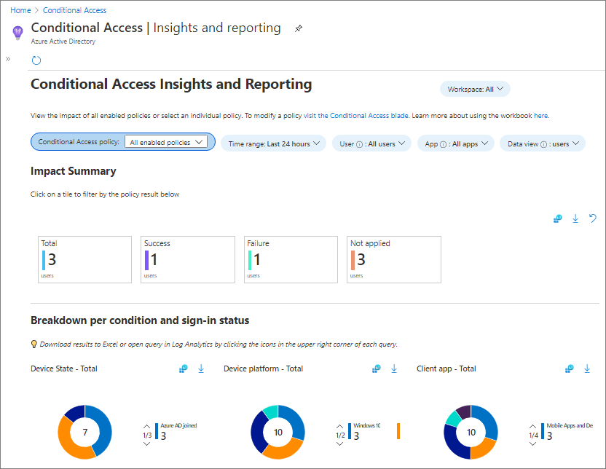
Conditional Access insights and reporting
Enables you to understand the impact of Conditional Access policies in your organization over time.
Lets you examine the impact of an individual policy or a subset of all policies.
Requires Azure AD log integration with Azure Monitor logs and a workspace to retain sign-in logs data.
Notes:
This is not part of Intune and is set up with Azure Monitor.
https://docs.microsoft.com/en-us/azure/active-directory/conditional-access/howto-conditional-access-insights-reporting
https://docs.microsoft.com/en-us/azure/active-directory/reports-monitoring/howto-integrate-activity-logs-with-log-analytics
https://docs.microsoft.com/en-us/azure/active-directory/reports-monitoring/howto-install-use-log-analytics-views

Slide 22
Best Practices: What to avoid
In your environment, you should avoid the following configurations
For all users, all cloud apps:
Block access. This configuration blocks your entire organization.
Require compliant device. For users that have not enrolled their devices yet, this policy blocks all access including access to the Intune portal. If you are an administrator without an enrolled device, this policy blocks you from getting back into the Intune portal to change the policy.
Require domain join. This policy block access has also the potential to block access for all users in your organization if you don't have a domain-joined device yet.
Require app protection policy. This policy block access has also the potential to block access for all users in your organization if you don't have an Intune policy. If you are an administrator without a client application that has an Intune app protection policy, this policy blocks you from getting back into portals such as Intune and Azure.
For all users, all cloud apps, all device platforms:
Block access. This configuration blocks your entire organization, which is definitely not a good idea.
Notes:
Best practices for Conditional Access in Azure Active Directory​
https://docs.microsoft.com/en-us/azure/active-directory/conditional-access/best-practices​
You should carefully review each configuration policy before releasing it to avoid undesirable results. In this context, you should pay special attention to assignments affecting complete sets such as all users / groups / cloud apps.

Slide 23
Common Conditional Access Policies
Typical policies deployed by organizations:
Block legacy authentication
Require MFA for administrators
Require MFA for Azure management
Require MFA for all users
Additional policies
Sign-on risk-based Conditional Access (Requires Azure AD Premium P2)
User risk-based Conditional Access (Requires Azure AD Premium P2)
Require trusted location for MFA registration
Block access by location
Require compliant device
Block access except specific apps
These four policies when configured together, mimic functionality enabled by security defaults.
Notes:
Common Conditional Access policies - Azure Active Directory | Microsoft Docs
https://docs.microsoft.com/en-us/azure/active-directory/conditional-access/concept-conditional-access-policy-common
Security defaults are great for some but many organizations need more flexibility than they offer. For example, many organizations need the ability to exclude specific accounts like their emergency access or break-glass administration accounts from Conditional Access policies requiring multi-factor authentication.

Slide 24
Microsoft Defender for Endpoint Integration
Enable integration with Intune
Security tasks
Audit reporting

Slide 25
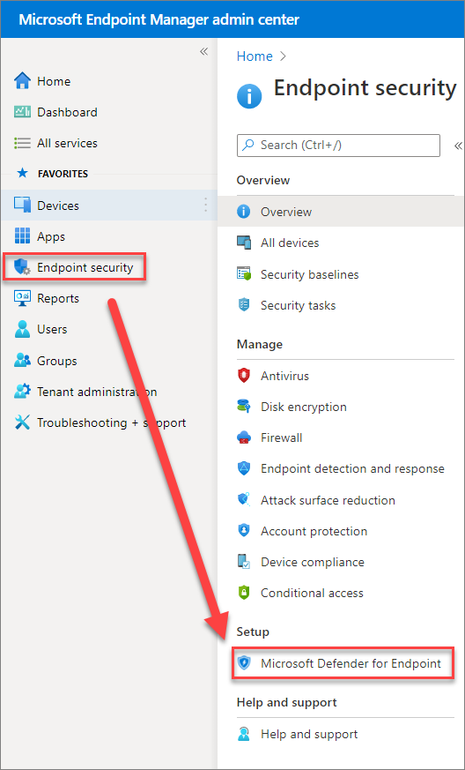
Microsoft Defender for Endpoint integration
Microsoft Intune and Microsoft Defender for Endpoint
Defender for Endpoint integration allows you to use dynamically calculated machine risk scores in Intune compliance evaluation and Azure Active Directory conditional access enforcement.​
Use Defender for Endpoint to gain visibility into your organization’s security posture and get recommendations to improve it.
Intune or Configuration Manager managed devices
To enroll Configuration Manager managed Windows 10 PCs and servers, Find the endpoint security policies for EDR under Manage in the Endpoint security node of the Microsoft Endpoint Manager admin center.
Security tasks
Created by Defender for Endpoint security admins with requests to remediate security issues discovered by Microsoft Defender Threat & Vulnerability Management (TVM). Intune admins can either accept or reject these requests.
Notes:
When you integrate Intune with Microsoft Defender for Endpoint (MDE), you can take advantage of Threat & Vulnerability Management (TVM) and use Intune to remediate endpoint weakness identified by TVM. This integration brings a risk-based approach to the discovery and prioritization of vulnerabilities that can improve remediation response time across your environment.
This capability will extend the newly announced Microsoft Defender Threat & Vulnerability Management (TVM), a new component of Microsoft Defender Advanced Threat Protection (Microsoft Defender ATP, previously Windows Defender ATP) that uses a risk-based approach to the discovery, prioritization, and remediation of endpoint vulnerabilities and misconfigurations.
Some examples of security tasks to remediate your security posture would be to update a vulnerable app, uninstalling a vulnerable app, updating an OS, or changing a device configuration.
https://docs.microsoft.com/en-us/intune/protect/atp-manage-vulnerabilities

Slide 26
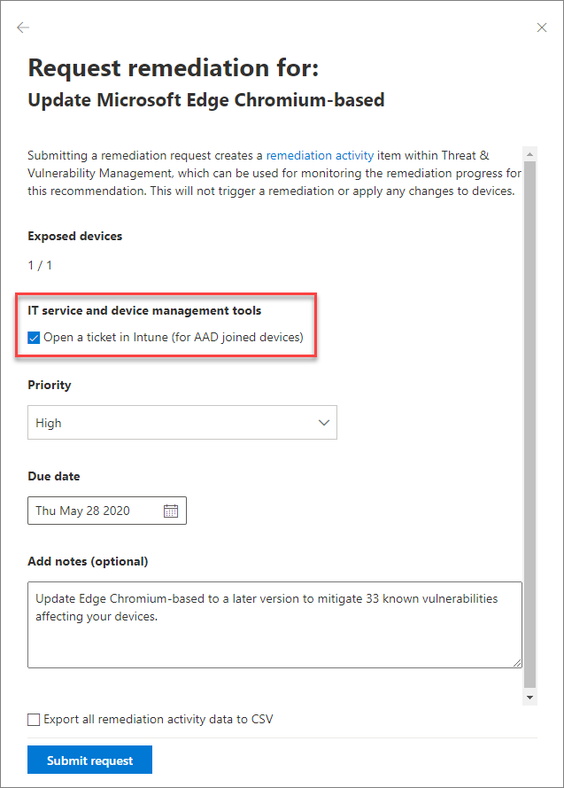
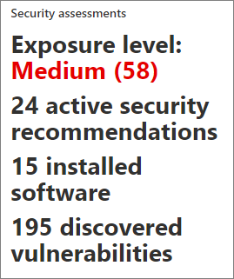
Defender for Endpoint security tasks
Creating an Intune security task is done from the Microsoft Defender Security Center.
Security tasks (Intune support tickets) are a remediation option for security recommendations based on the security assessment of a device.
Supported for Azure AD joined devices only.
Notes:
Microsoft Defender Security Center: https://securitycenter.windows.com/
Security tasks:
https://techcommunity.microsoft.com/t5/enterprise-mobility-security/microsoft-intune-security-tasks-extend-microsoft-defender-atp-s/ba-p/369857

Slide 27
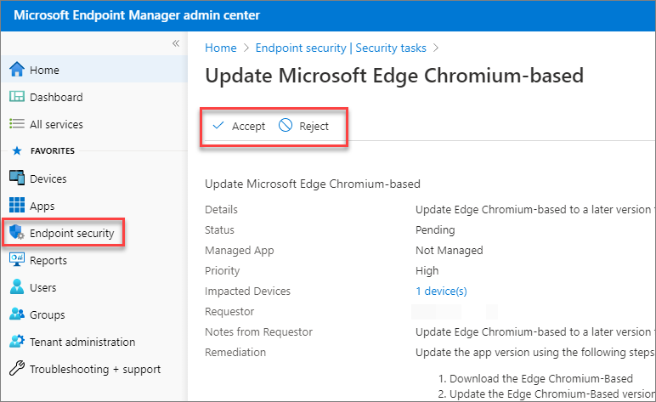
Defender for Endpoint security tasks
Microsoft Defender Security Center support tickets for Intune automatically appear in the MEM Admin Center as Security tasks under Endpoint security.
Intune administrators can Accept or Reject the request from the security team.
When accepted, the task shows as in progress. The final step after remediation steps are taken is to mark the task as complete.
All status updates are automatically synchronized with the Microsoft Defender Security Center.

Slide 28


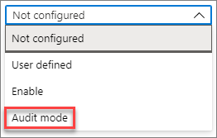
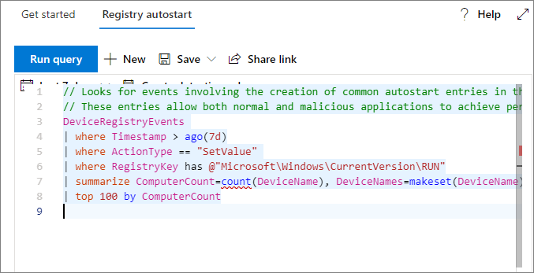
Defender for Endpoint reporting
Endpoint security policies work best with Defender for Endpoint integration which gives you detailed reporting into exploit events and auditing.
You can query Microsoft Defender for Endpoint data by using Advanced hunting in the Microsoft Defender Security Center.
If possible, audit first before enforcing endpoint security policies.
If you're using audit mode, you can use advanced hunting to see how exploit protection settings could affect your environment.
Notes:
https://docs.microsoft.com/en-us/mem/intune/protect/endpoint-security-asr-profile-settings
Application Guard, SmartScreen, Application Control can also be set using endpoint protection device configuration profiles.
Exploit protection works best with Microsoft Defender Advanced Threat Protection - which gives you detailed reporting into exploit protection events and blocks as part of the usual alert investigation scenarios.
https://docs.microsoft.com/en-us/windows/security/threat-protection/microsoft-defender-atp/exploit-protection#rule-block-credential-stealing-from-the-windows-local-security-authority-subsystem-lsassexe
Here is an example query:
KustoCopy
DeviceEvents | where ActionType startswith 'ExploitGuard' and ActionType !contains 'NetworkProtection’

Slide 29
Connecting to Microsoft Sentinel
Intune
Defender

Slide 30
Why Connect to Microsoft Sentinel?
Whole environment coverage
Storylines versus Alerts
Compliance as an Indicator
Automation
Quarantine
Remediation

Slide 31
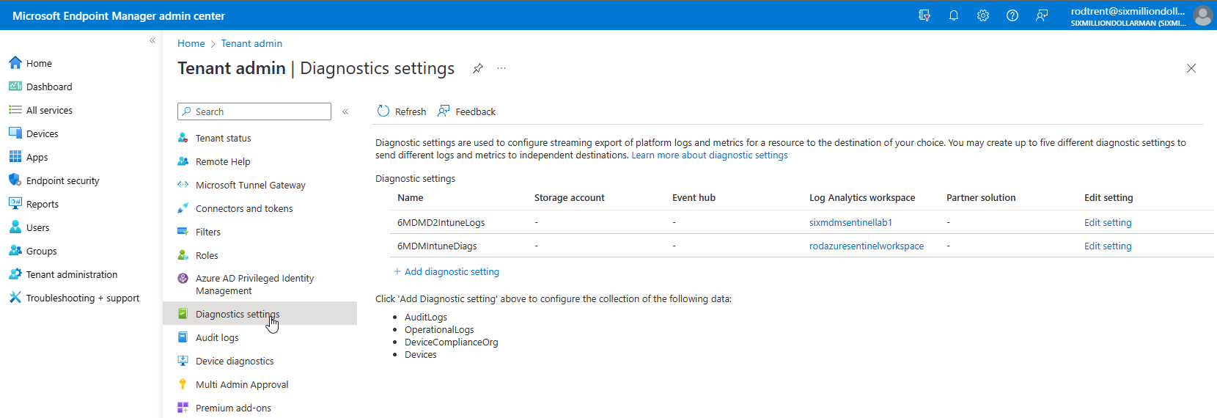
Microsoft Sentinel - Intune
Create a new Diagnostic Setting similar to the following but ensure that your own Subscription and Log Analytics Workspace (for Azure Sentinel) is selected. Also, make sure to select all log types (AuditLogs, OperationalLogs, DeviceComplianceOrg, and Devices).
Notes:
Route logs to Azure Monitor using Microsoft Intune | Microsoft Learn

Slide 32
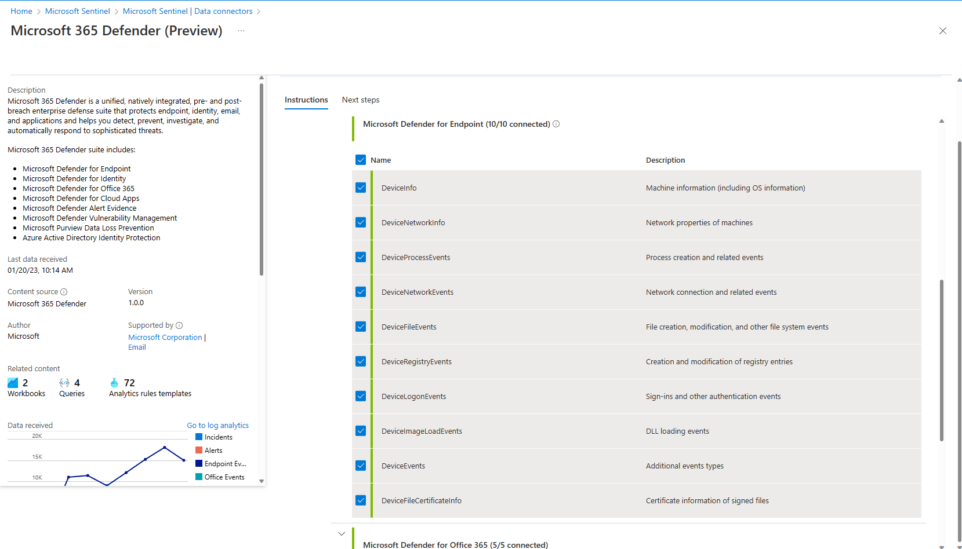
Microsoft Sentinel - Defender
Enable Microsoft Defender for Endpoint in the Microsoft 365 Defender connector in Microsoft Sentinel.
Notes:
Integrate Microsoft Defender for Endpoint with other Microsoft solutions | Microsoft Learn
Microsoft 365 Defender integration with Microsoft Sentinel | Microsoft Learn

